Slide 1
Setting and Achieving Goals
David Monahan

Slide 2
Goal:
noun
plural noun: goals
1.
(in football, rugby, hockey, and some other games) a pair of posts linked by a crossbar and typically with a
net between, forming a space into or over which the ball has to be sent in order to score.an instance of
sending the ball into or over the goal, especially as a unit of scoring in a game.
"the decisive opening goal"
a cage or basket used as a goal in other sports.
2.
the object of a person's ambition or effort; an aim or desired result.
"he achieved his goal of becoming King of England"
synonyms: | aim, objective, object, grail, holy grail, end, target, design, desire, desired result, intention, intent, plan, purpose, idea, point, object of the exercise; More

Slide 3

Why Set Goals?
Goals give you a target to aim for and keep you moving forward.
Goals help you stay focused on what it is you want to achieve.
Goals help to motivate you and give you something to strive for.
Goals give you control, they require you to make conscious decisions about what you are doing and where you are going.
Goals help to make tasks that seem insurmountable into something manageable.
Goals give you accountability, lets you evaluate you progress and see both your success and failures as they happen.
Failing to achieve goals is not a bad thing.

Slide 4
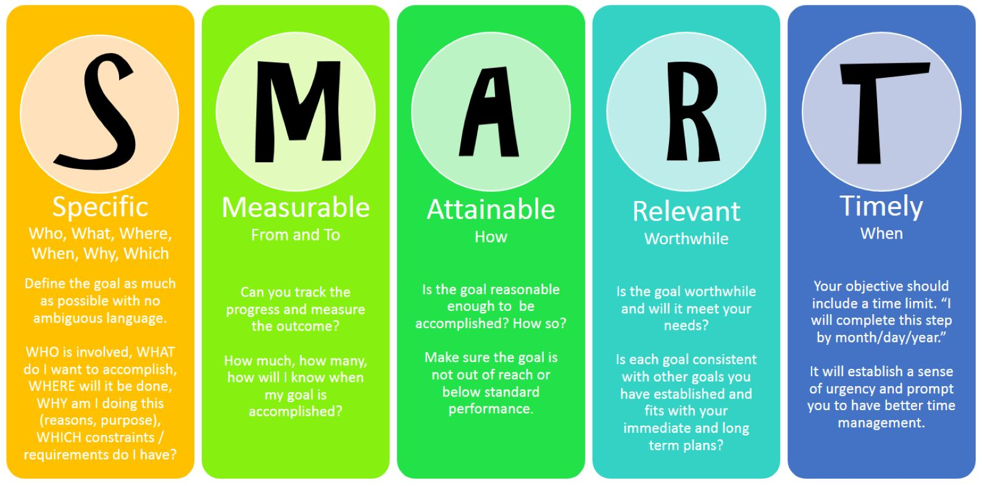
Setting Goals: S.M.A.R.T

Slide 5
Good and Bad Goals

Slide 6
Common mistakes:
Don’t set too many goals. Too many goals leads to a lack of focus and counters a large amount of the purpose of setting the goals in the first place.
Don’t be afraid to be ambitious with your goals.
Don’t be overly ambitious either.
Attainable just means you have a chance of achieving the goal, the chance does not have to be 100% to be worthwhile.

